Slide 1
Constraints约束
Foreign Keys
Local and Global Constraints Triggers

Slide 2
Constraints and Triggers
A constraint is a relationship among data elements that the DBMS is required to enforce.
Example: key constraints.
Triggers are only executed when a specified condition occurs, e.g., insertion of a tuple.
Easier to implement than complex constraints.

Slide 3
Kinds of Constraints
Keys.
Foreign-key, or referential-integrity.
Value-based constraints.
Constrain values of a particular attribute.
Tuple-based constraints.元组约束
Relationship among components.
Assertions:断言any SQL boolean expression.

Slide 4


Review: Single-Attribute Keys
Place PRIMARY KEY or UNIQUE after the type in the declaration of the attribute.
Example:
CREATE TABLE Beers (
name manf
CHAR(20) UNIQUE, CHAR(20)
);

Slide 5

Review: Multiattribute Key
The bar and beer together are the key for Sells:
CREATE TABLE Sells (
bar beer price
CHAR(20), VARCHAR(20), REAL,
PRIMARY KEY (bar, beer)
);

Slide 6
Foreign Keys
Values appearing in attributes of one relation must appear together in certain attributes of another relation.
Example: in Sells(bar, beer, price), we might expect that a beer value also appears in Beers.name .

Slide 7
Expressing Foreign Keys
Use keyword REFERENCES, either:
After an attribute (for one-attribute keys).
As an element of the schema:
FOREIGN KEY (<list of attributes>) REFERENCES <relation> (<attributes>)
Referenced attributes must be declared PRIMARY KEY or UNIQUE.

Slide 8

Example: With Attribute
CREATE TABLE Beers (
name manf
CHAR(20) PRIMARY KEY, CHAR(20) );
CREATE TABLE Sells (
bar beer price
CHAR(20),
CHAR(20) REFERENCES Beers(name), REAL );

Slide 9

Example: As Schema Element
CREATE TABLE Beers (
name manf
CHAR(20) PRIMARY KEY, CHAR(20) );
CREATE TABLE Sells (
bar beer price
CHAR(20),
CHAR(20), REAL,
FOREIGN KEY(beer) REFERENCES
Beers(name));

Slide 10
Enforcing Foreign-Key Constraints
If there is a foreign-key constraint from relation R to relation S, two violations are possible:
An insert or update to R introduces values not found in S.
A deletion or update to S causes some tuples of R to “dangle.”

Slide 11
Actions Taken --- (1)
Example: suppose R= Sells, S= Beers.
An insert or update to Sells that introduces a nonexistent beer must be rejected.
A deletion or update to Beers that removes a beer value found in some tuples of Sells can be handled in three ways (next slide).

Slide 12
Actions Taken --- (2)
Default: Reject the modification.
Cascade级联: Make the same changes in Sells.
Deleted beer: delete Sells tuple.
Updated beer: change value in Sells.
SetNULL: Change the beer to NULL.

Slide 13
Example: Cascade级联
Delete the Bud tuple from Beers:
Then delete all tuples from Sells that have beer = ’Bud’.
Update the Bud tuple by changing ’Bud’ to ’Budweiser’:
Then change all Sells tuples with beer = ’Bud’ to beer = ’Budweiser’.

Slide 14
Example: Set NULL
Delete the Bud tuple from Beers:
Change all tuples of Sells that have beer = ’Bud’ to have beer = NULL.
Update the Bud tuple by changing ’Bud’ to ’Budweiser’:
Same change as for deletion.

Slide 15
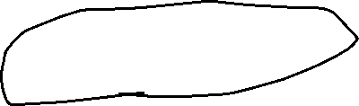
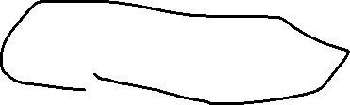
Choosing a Policy
When we declare a foreign key, we may choose policies SET NULL or CASCADE independently for deletions and updates.
Follow the foreign-key declaration by:
ON [UPDATE, DELETE][SET NULL CASCADE]
Two such clauses may be used.
Otherwise, the default (reject) is used.

Slide 16

Example: Setting Policy
CREATE TABLE Sells ( bar CHAR(20),
beer CHAR(20), price REAL, FOREIGN KEY(beer)
REFERENCES Beers(name) ON DELETE SET NULL
ON UPDATE CASCADE
);

Slide 17
Attribute-Based Checks
Constraints on the value of a particular attribute.
Add CHECK(<condition>) to the declaration for the attribute.
The condition may use the name of the attribute, but any other relation or attribute name must be in a subquery.

Slide 18


Example: Attribute-Based Check
CREATE TABLE Sells ( bar CHAR(20),
beer CHAR(20) CHECK ( beer IN (SELECT name FROM Beers)),
price REAL CHECK ( price <= 5.00 )
);

Slide 19


Timing of Checks
Attribute-based checks are performed only when a value for that attribute is inserted or updated.
Example: CHECK (price <= 5.00) checks every new price and rejects the modification (for that tuple) if the price is more than $5.
Example: CHECK (beer IN (SELECT name FROM Beers)) not checked if a beer is deleted from Beers (unlike foreign-keys).

Slide 20
Tuple-Based Checks
CHECK (<condition>) may be added as a relation-schema element.
The condition may refer to any attribute of the relation.
But other attributes or relations require a subquery.
Checked on insert or update only.

Slide 21

Example: Tuple-Based Check
Only Joe’s Bar can sell beer for more than $5:
CREATE TABLE Sells (
bar beer price
CHAR(20),
CHAR(20), REAL,
CHECK (bar = ’Joe’’s Bar’ OR
price <= 5.00)
);

Slide 22
Assertions断言
These are database-schema elements, like relations or views.
Defined by:
CREATE ASSERTION <name>
CHECK (<condition>);
Condition may refer to any relation or attribute in the database schema.

Slide 23
Example: Assertion
In Sells(bar, beer, price), no bar may charge an average of more than $5.
CREATE ASSERTION NoRipoffBars CHECK ( NOT EXISTS (
Bars with an average price above $5
SELECT bar FROM Sells
GROUP BY bar
HAVING 5.00 < AVG(price)
));

Slide 24



Example: Assertion
In Drinkers(name, addr, phone) and Bars(name, addr, license), there cannot be more bars than drinkers.
CREATE ASSERTION FewBar CHECK ( (SELECT COUNT(*) FROM Bars) <= (SELECT COUNT(*) FROM Drinkers)
);

Slide 25
Timing of Assertion Checks
In principle, we must check every assertion after every modification to any relation of the database.
A clever system can observe that only certain changes could cause a given assertion to be violated.
Example: No change to Beers can affect FewBar. Neither can an insertion to Drinkers.

Slide 26
Triggers: Motivation
Assertions are powerful, but the DBMS often can’t tell when they need to be checked.
Attribute- and tuple-based checks are checked at known times, but are not powerful.
Triggers let the user decide when to check for any condition.

Slide 27
Event-Condition-Action Rules
Another name for “trigger” is ECArule, or event-condition-action rule.
Event: typically a type of database modification, e.g., “insert on Sells.”
Condition: Any SQL boolean-valued expression.
Action: Any SQL statements.

Slide 28
Preliminary Example: A Trigger
Instead of using a foreign-key constraint and rejecting insertions into Sells(bar, beer, price) with unknown beers, a trigger can add that beer to Beers, with a NULL manufacturer.

Slide 29







Example: Trigger Definition
CREATE TRIGGER BeerTrig
The event
AFTER INSERT ON Sells
REFERENCING NEW ROW AS NewTuple FOR EACH ROW
The condition
WHEN (NewTuple.beer NOT IN
(SELECT name FROM Beers))
INSERT INTO Beers(name)
VALUES(NewTuple.beer);
The action

Slide 30

Options: CREATE TRIGGER
CREATE TRIGGER <name>
Or:
CREATE OR REPLACE TRIGGER <name>
Useful if there is a trigger with that name and you want to modify the trigger.

Slide 31




Options: The Event
AFTER can be BEFORE.
Also, INSTEAD OF, if the relation is a view.
A clever way to execute view modifications: have triggers translate them to appropriate modifications on the base tables.
INSERT can be DELETE or UPDATE.
And UPDATE can be UPDATE . . . ON a particular attribute.

Slide 32

Options: FOR EACH ROW
Triggers are either “row-level” or “statement-level.”
FOR EACH ROW indicates row-level; its absence indicates statement-level.
Rowlevel-triggers: execute once for each modified tuple.
Statement-leveltriggers: execute once for a SQL statement, regardless of how many tuples are modified.

Slide 33

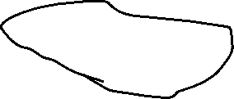

Options: REFERENCING
INSERT statements imply a new tuple (for row-level) or new table (for statement-level).
The “table” is the set of inserted tuples.
DELETE implies an old tuple or table.
UPDATE implies both.
Refer to these by
[NEW OLD][TUPLE TABLE] AS <name>

Slide 34
Options: The Condition
Any boolean-valued condition.
Evaluated on the database as it would exist before or after the triggering event, depending on whether BEFORE or AFTER is used.
But always before the changes take effect.
Access the new/old tuple/table through the names in the REFERENCING clause.

Slide 35
Options: The Action
There can be more than one SQL statement in the action.
Surround by BEGIN . . . END if there is more than one.
But queries make no sense in an action, so we are really limited to modifications.

Slide 36
Another Example
Using Sells(bar, beer, price) and a unary relation RipoffBars(bar), maintain a list of bars that raise the price of any beer by more than $1.

Slide 37







The Trigger
The event – only changes to prices
CREATE TRIGGER PriceTrig
AFTER UPDATE OF price ON Sells
REFERENCING
OLD ROW AS ooo NEW ROW AS nnn
Updates let us talk about old and new tuples
We need to consider
Condition: a raise in price > $1
FOR EACH ROW
each price change
When the price change is great enough, add the bar to RipoffBars
WHEN(nnn.price > ooo.price + 1.00)
INSERT INTO RipoffBars
VALUES(nnn.bar);

Slide 38
SQL SERVER Trigger
CREATE TRIGGER PriceTrig
ON Sells FOR UPDATE AS
The event only changes to prices
Updates let us talk about old
IF ( BEGIN
UPDATE(PRICE))
and new tuples
IF(
inserted.price > .price + 1.00
)
Condition: a raise in price > $1
deleted
INSERT INTO RipoffBars
VALUES(inserted.bar)
;
When the price change is great enough, add the bar to RipoffBars
END

Slide 39
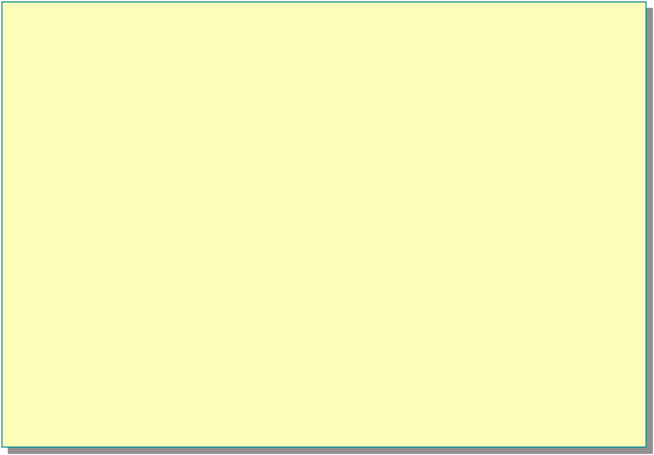
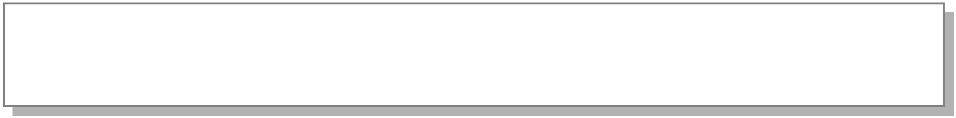

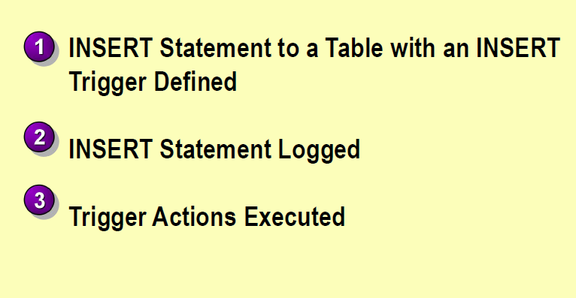










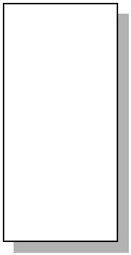
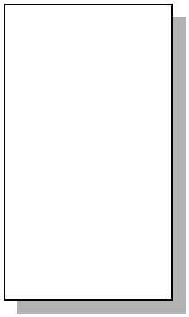
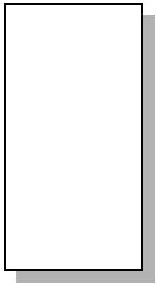















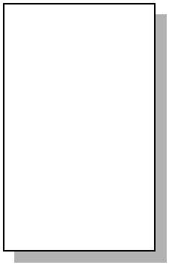


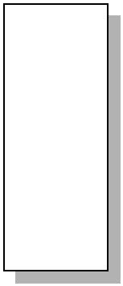
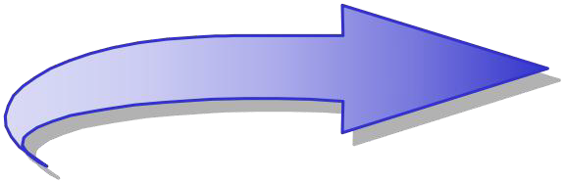


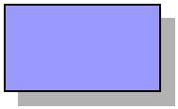
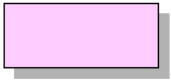
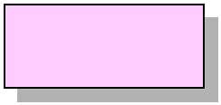









How an INSERT Trigger Works
INS_{T}E_{R}R_{IG}T_{G}s_{E}ta_{R}te_{A}m_{c}e_{ti}n_{o}t_{n}t_{s}o_{E}a_{x}t_{e}a_{c}b_{u}le_{te}with an INSERT Trigger Defined
INSERT [Orde_{Tri}D_{g}e_{g}t_{e}a_{r}il_{C}s_{o}]_{de}V:ALUES
⁽¹⁰I⁵N²S⁵E, R²T, S¹t⁹a.t⁰e⁰m, e⁵n,t t⁰o^{.2}a⁾ Table with an INSERT
CREATE TRIGGER OrdDet_Insert
Trigger DOeNfin[eOdrder Details]
FOR INSERT
ASOrderID ProductID UnitPrice Quantity Discount
INSERT S^{U}ta^{P}t^{D}e^{A}m^{TE}en^{P}t ^{S}LEo^{T}gged
PDATE P SET
^{U} 10522 10 31.00 7 0.2
UnitsInStock = (P.UnitsInStock – I.Quantity)
FR1O0M52P3rod4u1cts A9S.65P INN9ER J0O.1I5N Inserted AS I ON₁₀P₅.₂P₄rodu₇ctID₃₀=_{.00}I.Pr₂o₄ductI_{0.}D₀
UnitsInStock = (P.UnitsInStock – I.Quantity)
FROM Products AS P INNER JOIN Inserted AS I
_{Trigger Ac}O_{t}N_{io}P_{n}._{s}Pr_{E}o_{x}d_{e}u_{c}c_{u}tI_{te}D_{d}= I.ProductID
10523 2
OrderID ProductID UnitPrice Quantity Discount
19.00 5
0.2
10522 10 31.00 7
¹In⁰⁵s²e³rt st⁴a¹teme⁹n^{.6}t⁵logge⁹d
ProductID UnitsInStock … …
1 15
2 15
0.2
0.15
10524 | 7 | 30.00 | 24 | 0.0
10523 | 2 | 19.00 | 5 | 0.2
2
10
3
4
65
20
10523
2
19.00
5
0.2

Slide 40

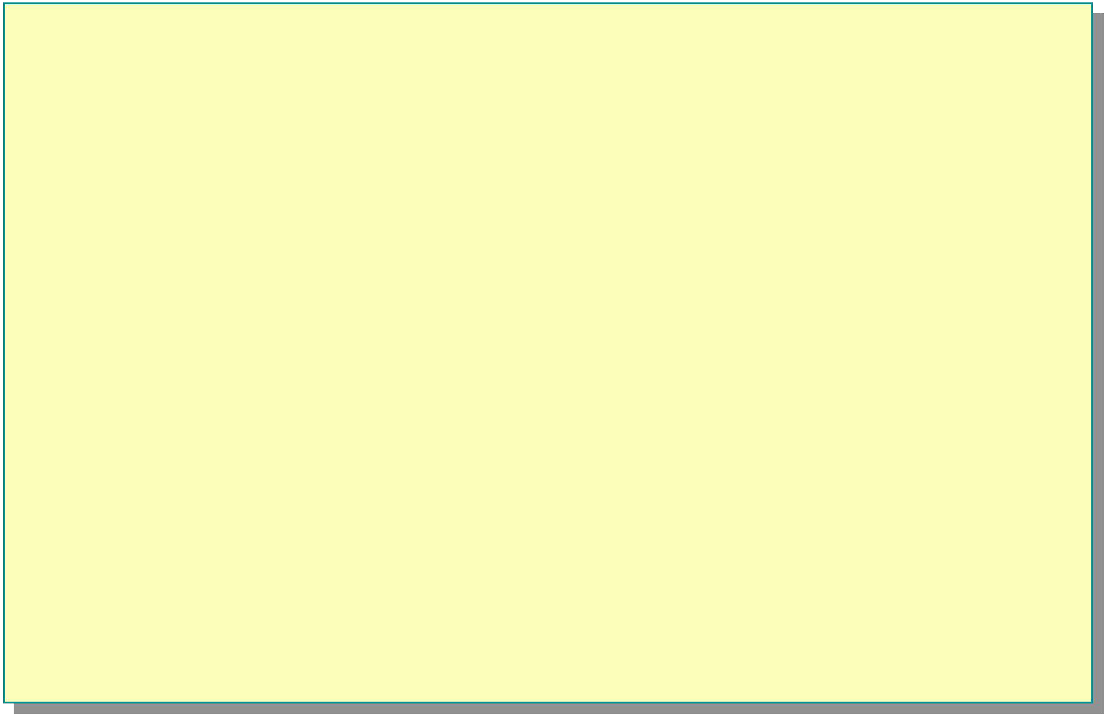

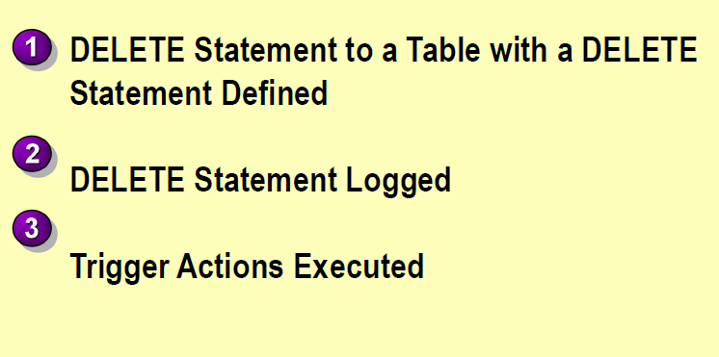




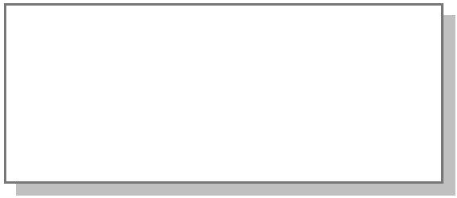
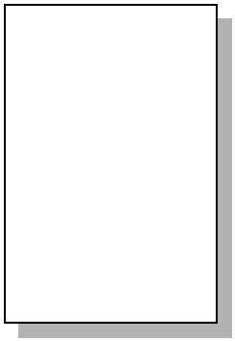

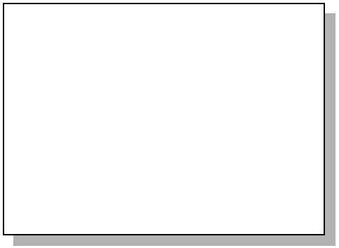
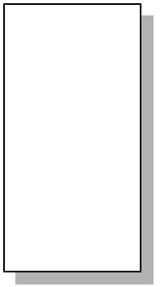








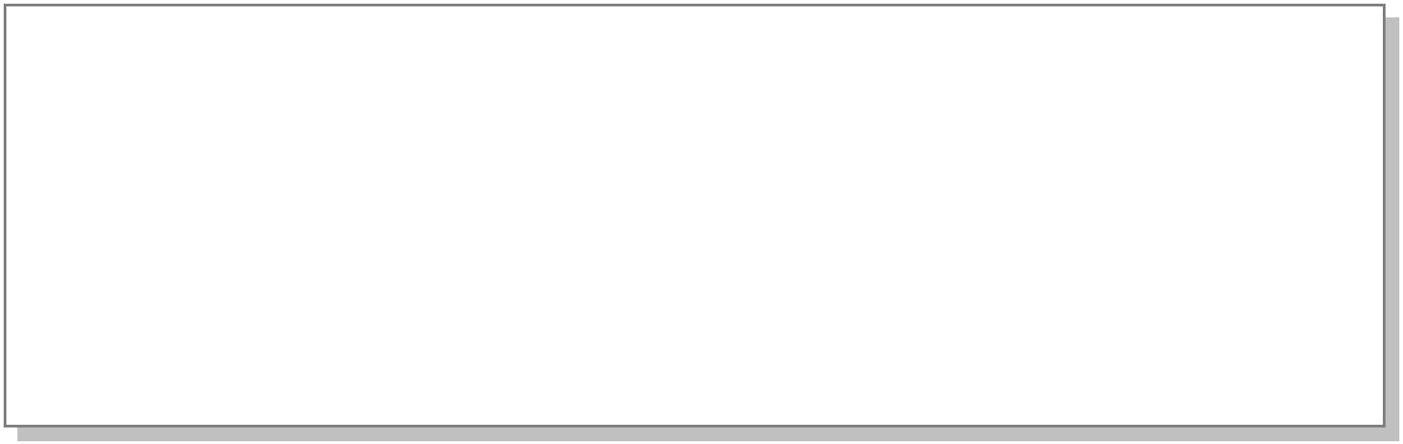


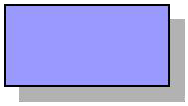
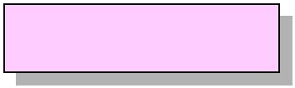
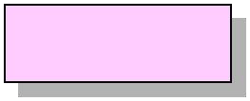
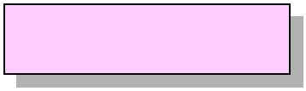










How a DELETE Trigger Works
DELETE Statement to a table with a DELETE Trigger Defined
Trigger Actions Execute
CategoryID CategoryName
DELETE Categories
Description Picture
1 Beverages
Soft drinks, coffees… 0x15…
WHERE
DELETE Statem2ent toCoandTimaebnltes witShweaetDaEndLsEavToEry …
0x15…
CategoryID = 4
3
Confections ^{Pro}D^{d}e^{u}s^{ct}s^{ID}ert^{D}s^{i},^{s}c^{co}a^{n}n^{t}d^{in}ie^{ue}s^{d}, …… 0…x15…
Statement Defined
1
2 1
4
Dairy Products
Cheeses
0
0x15
…
CREATE _{D}TR_{E}I_{L}GG_{E}E_{T}R_{E}C_{S}a_{t}t_{a}e_{t}g_{e}o_{m}ry_{e}__{n}D_{t}e_{L}le_{o}t_{g}e_{ged}
2 0
3
4
0
0
ON Categories FOR DELETE
AS
Trigger Actions Executed
UPDATE P SET Discontinued = 1
FROM Products AS P INNER JOIN deleted AS d ON DPE.CLaEtTeEgosrtyaIteDm=endt.lCoagtgeegdoryID
UPDATE P SET Discontinued = 1
FROM Products AS P INNER JOIN deleted AS d ON P.CategoryID = d.CategoryID
4 Dairy Products Cheeses 0x15…

Slide 41

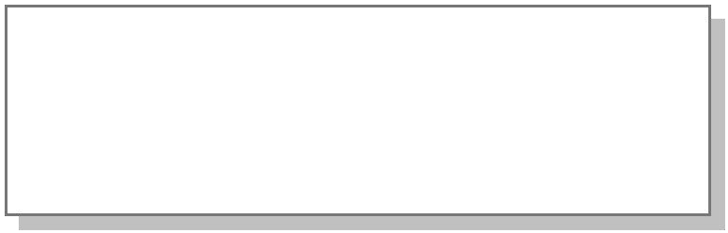








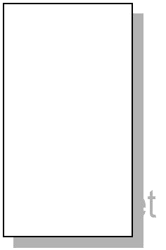


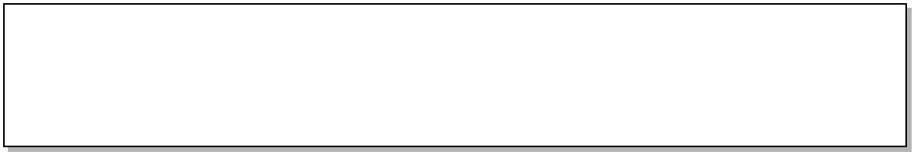







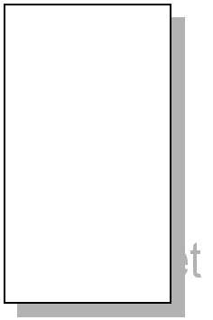

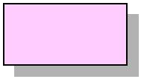
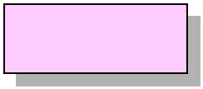
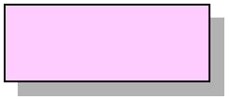




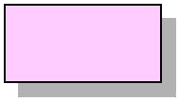
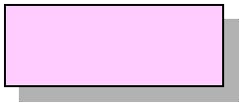
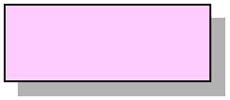
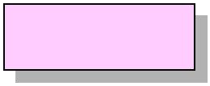













How an UPDATE Trigger Works
TRIGGER Actions Execute
CREATE TRIGGER Employee_Update ON Employees
FOR UPDATE
AS
IF UPDATE (EmployeeID) BEGIN TRANSACTION
RAISERROR ('Transaction cannot be processed.\
***** Employee ID number cannot be modified.', 10, 1) ROLLBACK TRANSACTION
Transaction cannot be processed.
***** Member number cannot be modified
EmployeeID LastName FirstName Title HireDate
1 Davolio Nancy Sales Rep. ~~~
2 Fuller Andrew Vice Pres. ~~~
3 Leverling Janet Sales Rep. ~~~
4 Peacock MargaretSales Rep. ~~~
UPDATE Statement to a table with an UPDATE Trigger Defined
UPDATE Employees SET EmployeeID = 17
WHERE EmployeeID = 2
EmployeeID LastName FirstName Title HireDate
1 Davolio Nancy Sales Rep. ~~~
2 Fuller Andrew Vice Pres. ~~~
3 Leverling Janet Sales Rep. ~~~
4 Peacock MargaretSales Rep. ~~~
UPDATE Statement logged as INSERT and DELETE Statements
17 Fuller Andrew Vice Pres. ~~~
2 Fuller Andrew Vice Pres. ~~~
UPDATE Statement to a Table with an UPDATE Trigger Defined
UPDATE Statement Logged as INSERT and DELETE Statements
Trigger Actions Executed
AS
IF UPDATE (EmployeeID) BEGIN TRANSACTION
RAISERROR ('Transaction cannot be processed.\
***** Employee ID number cannot be modified.', 10, 1) ROLLBACK TRANSACTION
2
Barr
Andrew
R
~~~
2
Barr
Andrew
R
~~~

Slide 42
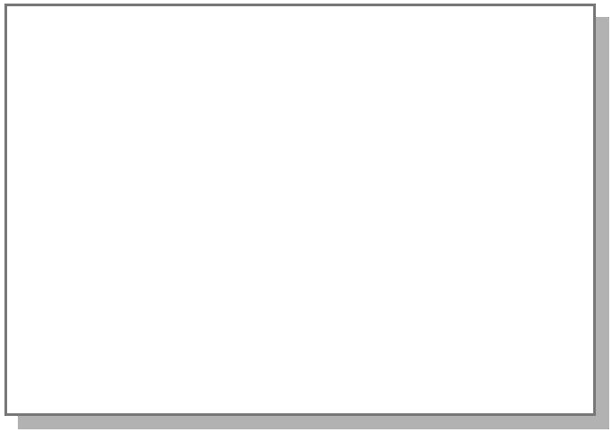








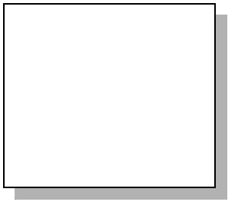
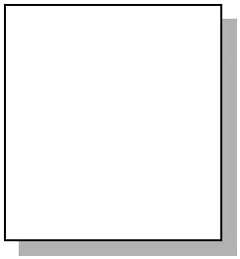
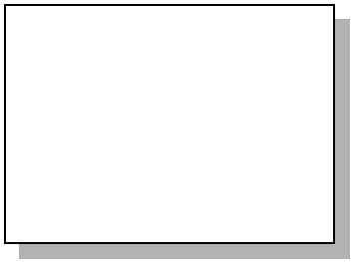


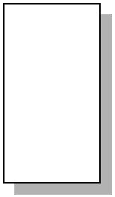







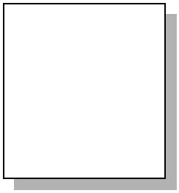
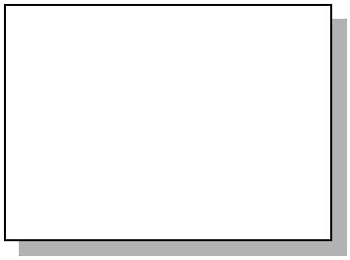
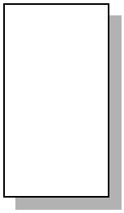






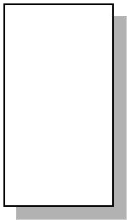




How an INSTEAD OF Trigger Works
Create a View That Combines Two or More Tables
U^{C}P^{R}DEA^{AT}T^{E}E ^{V}is^{IE}M^{W}ade
_{to}Cu_{th}st_{e}o_{V}m_{i}e_{e}r_{w}s AS
SELECT *
FROM CustomersMex
INUSNITOENAD OF
_{trSigEgLEeCrTdi*rects the} CustomerID CompanyName Country Phone …
up^{F}d^{R}a^{O}t^{M}e t^{C}o^{us}th^{to}e^{m}b^{e}a^{r}s^{sG}e^{er} ALFKI Alfreds Fu… Germany 030-0074321 ~~~
table ANATR Ana Trujill… Mexico (5) 555-4729 ~~~ ANTON Antonio M… Mexico (5) 555-3932 ~~~
Original Insert to
the Customers
CVusiteomwerIDDoCeomspaNnoyNtame Country Phone …
^{O}AN^{c}A^{c}T^{u}R^{r} Ana Trujill… MexCiucsotome(r5ID) 5C5o5m-p4a7n2y9Name~~C~ountry Phone …
^{ANTON Antonio M… Me} ALFKI Alfreds Fu…~ Germany 030-0074321 ~~~ CENTC Centro Co… Mexic_{B}o_{LAUS}(5) 5_{B}55_{la}-_{u}3_{e}3_{r}92_{Se…}~~_{G}~_{ermany 0621-08460 ~~~}
DRACD Drachenb… Germany 0241-039123 ~~~
INSTEAD OF Trigger Can Be on a Table or View
The Action That Initiates the Trigger Does NOT Occur Allows Updates to Views Not Previously Updateable
ALFKI
Alfreds Fu…
Germany
030-0074321
~~~
xic_{A}o_{LFK}(_{I}5)
⁵A⁵⁵lf⁻r³e⁹d³s²Fu…
~G~ermany
030-0074321
~~~

Slide 43

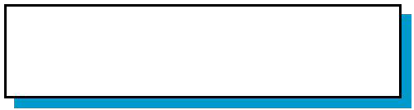







How Nested Triggers Work
OrDe_Update
OrderID ProductID UnitPrice Quantity Discount
 | 10522 | 10 | 31.00 | 7 | 0.2
 | 10523 | 41 | 9.65 | 9 | 0.15
 | 10524 | 7 | 30.00 | 24 | 0.0
 | 10525 | 2 | 19.00 | 5 | 0.2
Placing an order causes the OrDe_Update trigger to execute
Executes an UPDATE statement on the Products table
InStock_Update
ProductID UnitsInStock … …
1 15
2 15
10
3
4
65
20
InStock_Update trigger executes
Sends message
UnitsInStock + UnitsOnOrder is < ReorderLevel for ProductID 2

Slide 44
Recursive递归Triggers
Activating a Trigger Recursively
Types of Recursive Triggers
Direct recursion occurs when a trigger fires
and performs an action that causes the
same trigger to fire again
Indirect recursion when a trigger fires and performs an action that causes a trigger on another table to fire
Determining Whether to Use Recursive Triggers

Slide 45
Examples of Triggers
Enforcing Data Integrity完整性
Enforcing Business Rules

Slide 46






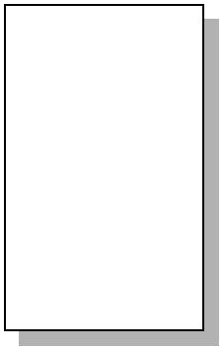
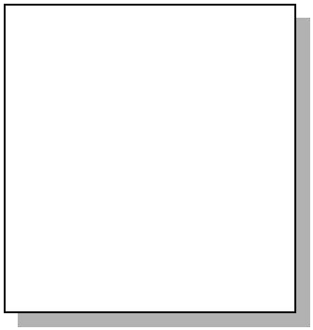
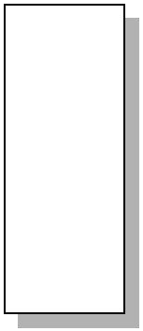


Enforcing Data Integrity
CREATE TRIGGER BackOrderList_Delete ON Products FOR UPDATE
AS
IF (SELECT BO.ProductID FROM BackOrders AS BO JOIN Inserted AS I ON BO.ProductID = I.Product_ID
) > 0
BEGIN
DELETE BO FROM BackOrders AS BO INNER JOIN Inserted AS I
ON BO.ProductID = I.ProductID
END
ProductID UnitsInStock … …
ProductID UnitsOnOrder …
1 15
12 10
3 65
1 15
2 15
Updated
10
3
4
65
20
Trigger Deletes Row
2
15

Slide 47



















Enforcing Business Rules
Products with Outstanding Orders Cannot Be Deleted
IF (Select Count (*)
FROM [Order Details] INNER JOIN deleted
ON [Order Details].ProductID = deleted.ProductID
) > 0
ROLLBACK TRANSACTION
DELETE statement executed on Product table
Trigger code
checks the Order Details table
Transaction rolled back
ProductID UnitsInStock … …
OrderID ProductID UnitPrice Quantity Discount
1 | 15 |  | 10522 | 10 | 31.00 | 7 | 0.2
2 | 0 |  | 10523 | 2 | 19.00 | 9 | 0.15
3 | 65 |  | 10524 | 41 | 9.65 | 24 | 0.0
4 | 20 |  | 10525 | 7 | 30.00
2
10
10
9
'Transaction cannot be processed' 'This product has order history'

Slide 48






















Deciding Which Enforcement Method to Use
Constraints
Medium
Low
Before
Defaults and rules Low
Low
Before
Triggers
High
Medium-High
After
Data types, Null/Not Null
Low
Low
Before

